Slide 1


Forge Your Data Engineer In A Box
Turning JSON Chaos into Analytics-Ready Data with AI

Slide 2

Data Teams Are Drowning in JSON
85% of contemporary APIs deliver nested JSON, whereas analytics platforms need flat table structures.
🔥 Manual unnesting of complex schemas such as Stripe and Salesforce can take 6 to 12 months
🔥 Engineering expenses range from $200K to $500K annually to sustain fragile transformation code
🔥 Pipeline disruptions occur whenever APIs update due to schema changes
🔥 95% of teams redundantly develop the same transformation processes independently

Slide 3

Introducing Forge: Automated dbt Generation for JSON Data
🔥 Seamlessly parses complex nested JSON schemas
🔥 Produces production-quality dbt models within 2-5 minutes
🔥 Excalibur’s AI-driven schema intelligence accurately predicts field types
🔥 Pridwen governance AI engine automatically identifies PII
🔥 Supports simultaneous model output for four data warehouses (BigQuery, Snowflake, Databricks, Redshift), eliminating vendor lock-in
🔥 Transform JSON into analytics in minutes, not months

Slide 4
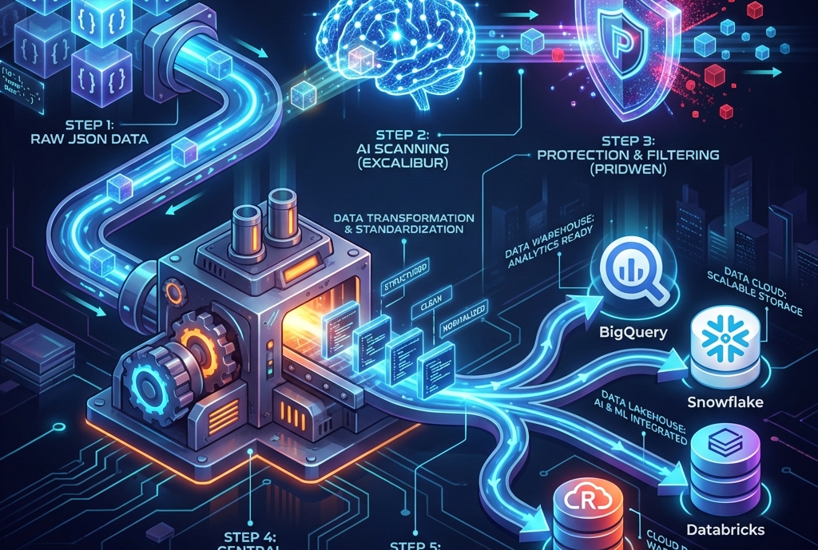
Pipelines Up and Running In Minutes, Not Days
🔥 5 Minute set up for users — fully automated pipelines
🔥Cross-Warehouse Compilation — One parse, four warehouse outputs
🔥 Privacy-First AI — Field names hashed, no data transmitted
🔥 Schema Evolution Tracking — Automatic versioning and migration

Slide 5

Competitive Differentiation
Feature | Forge | Fivetran | Airbyte | Manual dbt
Automated dbt Generation | 🔥Yes | ❌ No | ❌ No | ❌ Manual
AI Schema Intelligence | 🔥 Excalibur + Pridwen | ❌ No | ❌ No | ❌ No
Multi-Warehouse (1 job) | 🔥 All 4 | ❌ Single | ❌ Single | ❌ Single
PII Auto-Detection | 🔥 97% coverage | ⚠️ Basic | ⚠️ Basic | ❌ Manual
Time to Production | ⚡ 5 minutes | 🐌 Days | 🐌 Days | 🐌 Months
Pricing | 💰 $299 – 1K+/mo | 💰💰💰 $2K+/mo | 💰 $0-2K/mo | 💰💰 Eng cost

Slide 6

Production-Ready Enterprise Architecture
🗡️ Excalibur — GraphSAGE GNN + RandomForest for schema intelligence
128-dimensional embeddings, privacy-preserving (hashed field names)
🛡️ Pridwen — 3-Layer Governance Engine (Rules + ML + Crowd Consensus)
k-anonymity, differential privacy
🔥 SaaS: Serverless Google Cloud Run (5-min setup)
🔥 Enterprise: GKE in customer VPC (full data sovereignty)
🔥 Observability: Grafana + Prometheus deployed
🔥 Security: SOC 2 Type II in progress

Slide 7

Product Roadmap
Our goal is to develop a fully AI-driven data transformation platform requiring no manual coding, enabling businesses to save between $200K and $500K on API migrations.
In Production (Currently):
🔥 Forge Core — JSON to dbt engine conversion
🗡️ Excalibur — Schema intelligence capabilities
🛡️ Pridwen — Governance engine
Planned Features (2026-2027):
🐴 Llamrei (Q3 2026) — Engine for schema evolution
🧙‍♂️ Merlin (Q4 2026) — LLM-powered orchestrator for autonomous, self-healing data pipelines
🔥 Automated translation of legacy API versions to modern schemas
🔥 Cross-API conversions (e.g., transforming Square data into Stripe format)

Slide 8

Market Opportunity
$12B+ Total Addressable Market in Data Transformation
Target Audience:
🔥 Over 500,000 companies utilizing modern SaaS APIs such as Stripe, Salesforce, HubSpot, and Shopify
🔥 Rapid growth in data teams adopting dbt, with a 50% year-over-year increase
Market Trends:
🔥 More than 8,000 companies have adopted dbt, experiencing 50% annual growth
🔥 Surge in JSON APIs, with 85% now delivering nested JSON responses
🔥 Increasing data governance demands driven by regulations like GDPR and CCPA, boosting the need for PII detection
Serviceable Addressable Market (SAM): $2.4B
🔥 Approximately 200,000 data teams, each with an average contract value of $12,000
AI-powered dbt code generation enables a 100x acceleration compared to manual coding

Slide 9

High-Margin SaaS with Enterprise Upsell
SaaS (Cloud Run):
🔥 Starter: $299 per month (Startups, small teams)
🔥 Professional: $999 per month (SMB - Enterprise)
Enterprise (GKE within Customer VPC):
🔥 $6,000 – $20,000/ per month ($72,000 – $200k+ annually) for specialized solutions
Unit Economics:
💰 Gross Margin: Approximately 85% (leveraging serverless infrastructure)
💰 Customer Acquisition Cost (CAC) Payback Period: 6 to 9 months (through GCP Marketplace)
💰 Lifetime Value to CAC Ratio Target: 5:1 🔥 Available Exclusively through Google Cloud Marketplace, featuring integrated billing and Google’s vetting process.

Slide 10

Technical Founder with Deep Domain Expertise
Founder Brady Bastian has built Foxtrot Communications into a trusted partner for data engineering excellence. His track record includes designing and implementing enterprise-scale data architectures, warehousing solutions, and automated pipelines for companies across industries. Certified as both a GCP Professional Data Engineer and Professional Cloud Architect, Brady combines technical mastery with real-world business impact. I first built the JSON parser to help myself break down difficult to parse JSON objects. The more colleagues I spoke to, the more it became apparent that this was a shared problem for nearly every company. So, I decided to build Forge and expand the feature set to encompass an AI suite that can power enterprise data teams.

Slide 11

Seeking Seed Round: $2M at $10M Post-Money
🧪 Finalize the Merlin LLM orchestrator by Q4 2026
Increase warehouse support by adding 2-3 additional locations
Achieve SOC 2 Type II certification
📢 30% Go-to-Market ($600K)
Hire the first GTM leader (Head of Growth)
Focus on content marketing, SEO, and paid advertising channels
Develop community engagement through conferences and dbt meetups
⚙️ 20% Operations ($400K)
Build customer success infrastructure
Ensure legal and compliance adherence (GDPR, CCPA)
Maintain a 12-18 month financial runway

Slide 12
Contact
Forge Data Platform AI-Powered Data Transformation
Website: https://forge.foxtrotcommunications.net/ Contact: brady.bastian@foxtrotcommunications.net
Company: Foxtrot Communications Corporation
GCP Marketplace: https://console.cloud.google.com/marketplace/product/foxtrot-communications-public/forge-saas-standard

